Slide 1
EMPLOYEE ATTRITION PREDICTION AND ANALYSIS
Introduction
Jeevan Jose
MCA semester VI
Department of Computer Applications Government Engineering college Thrissur
Guided by, Aswathy M C

Slide 2
Introduction
Introduction
Employee Attrition is the gradual reduction in staff numbers that occurs as employees retire or resign and are not replaced. Employee attrition can be costly for businesses. The company loses employee productivity, and employee knowledge.
Why do we predict attrition? Predictive Attrition Model helps in not only taking preventive measures but also into making better hiring decisions. Deriving trends in the candidate’s performance out of past data is important in order to predict the future trends, as well as to board new employees.
It helps in Managing workforce, Smooth pipeline, Hiring Management

Slide 3
Important Features
Introduction
Job satisfaction Environment satisfaction Work life balance
Job Involvement Current position Years at company
Number of companies worked Years since last promotion Years under same manager
Performance rating Relationship satisfaction Total working hours Training times last year

Slide 4
Questionnaire
Introduction
Job Satisfaction
Do you feel valued for your contributions?
Do your superiors communicate company news effectively and in a timely manner?
Does management seem invested in the success of the team? Do your managers value your feedback?
Do you enjoy our company’s culture?

Slide 5
Questionnaire
Introduction
Environment Satisfaction
My organization is dedicated to diversity and inclusiveness? My organization’s fiscal well-being is stable
My organization operates in a socially responsible manner I’m overall satisfied with my job security
My organization has a safe working environment

Slide 6
Questionnaire
Introduction
Work Life Balance
I often neglect my personal needs due to the stress of my work.
My work suffers because of everything going on in my personal life.
I often need to make difficult choices between my work and my personal life.
I return home from work too tired to try to do things I wish to do
My job makes it difficult to take care of the type of private life I might like

Slide 7
Questionnaire
Introduction
Job Involvement
You consider yourself as an efficient contributor to the team
You have an input in the decisions that are taken in your organization
You are enjoying the work you are doing on a daily basis Do you feel connected to your group members

Slide 8
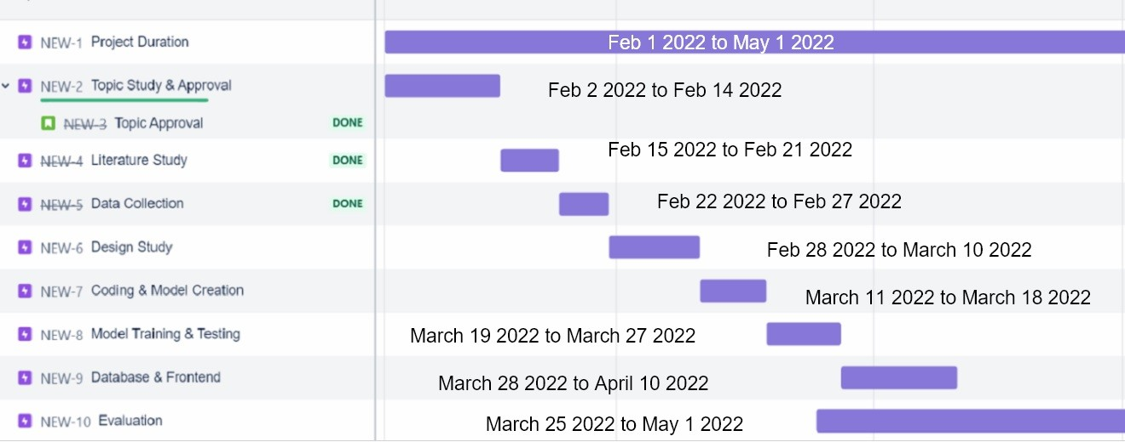
Introduction
Project progress
Figure 1:

Slide 9
THANK YOU
Introduction

